Slide 1

Leandro Bracho Nicholas Joseph Oscar Medrano Robin Smithson
Arbitrary Waveform
Generator

Slide 2
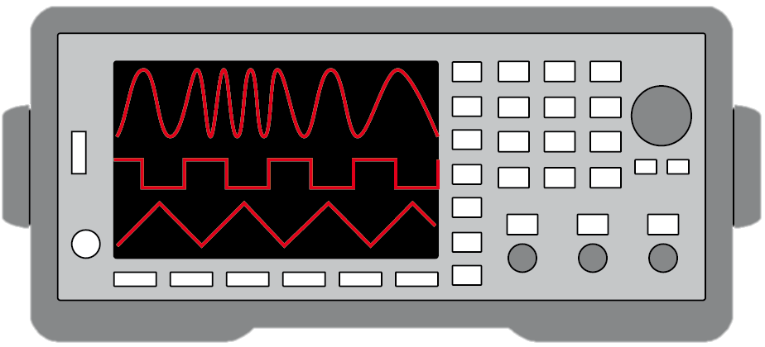
Project Description
Problem Statement:
Test validation is a vital step in the design and fabrication of circuit boards for any project in the realm of electrical engineering.
Typical AWGs can be large and unintuitive
Solution Proposal:
Create a mobile user interface for the AWG
Design an AWG with decent quality
Allow hand drawn waveforms
Notes:
Nick

Slide 3
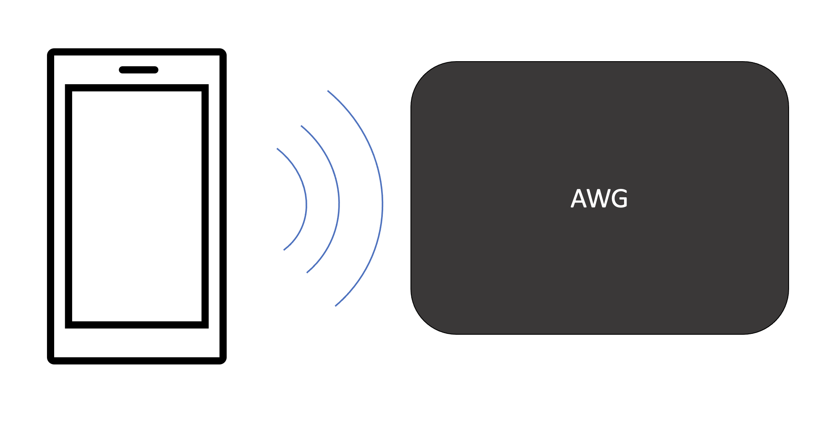
System Overview
Leandro Bracho
Nicholas Joseph, Oscar Medrano, and Robin Smithson
Android Interface
Notes:
Robin

Slide 4
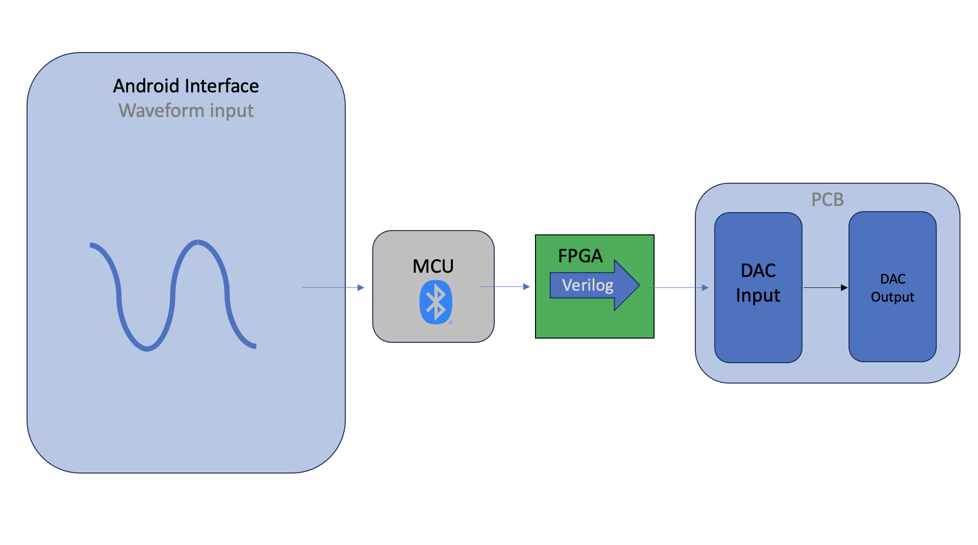
Subsystem Overview
Leandro Bracho
Robin Smithson
Nicholas Joseph
Oscar Medrano
Notes:
Robin (or Leandro or Oscar)

Slide 5
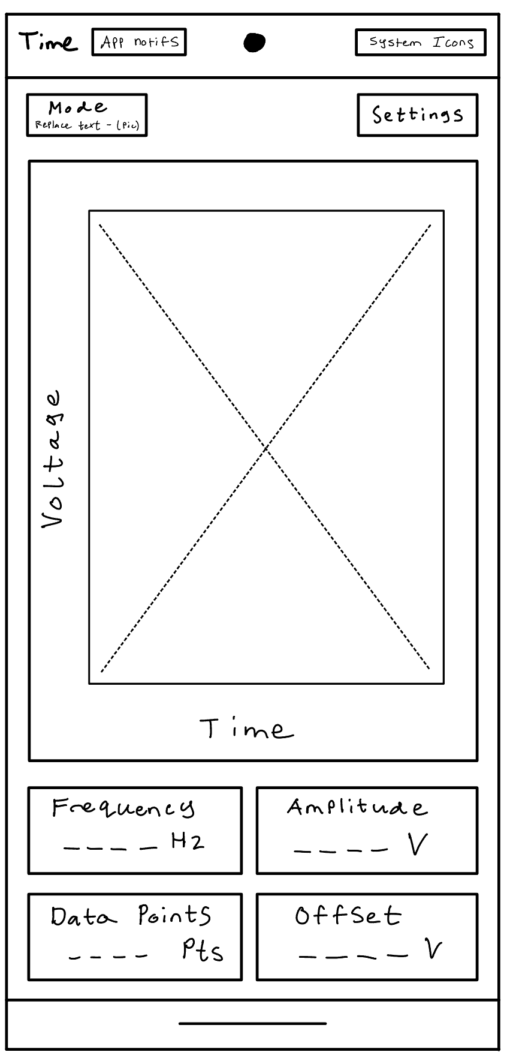
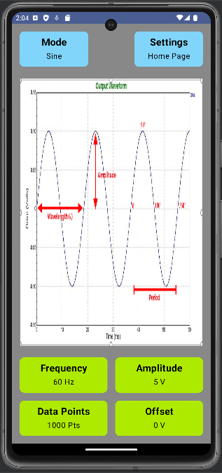
Android Interface
Allows import/export of CSV files
Provides GUI to user’s android phone
Replaces on-board UI of a typical AWG
Communicates with the Microcontroller via Bluetooth

Slide 6
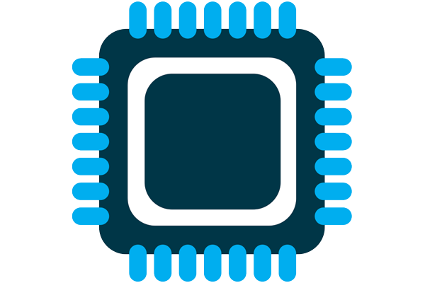
Microcontroller
Connects to Android app via Bluetooth
Imports data points
Sets clock rate
Exports data points to FPGA
Using ESP32 – WROVER

Slide 7
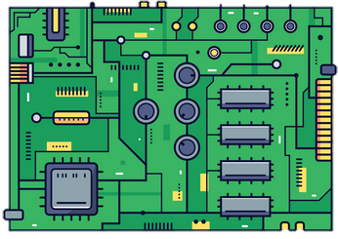
FPGA
Take the information from the microcontroller
Be designed to produce any wave
Have a design of 20KHz
Produce correct waveform

Slide 8
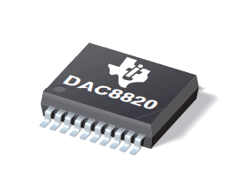
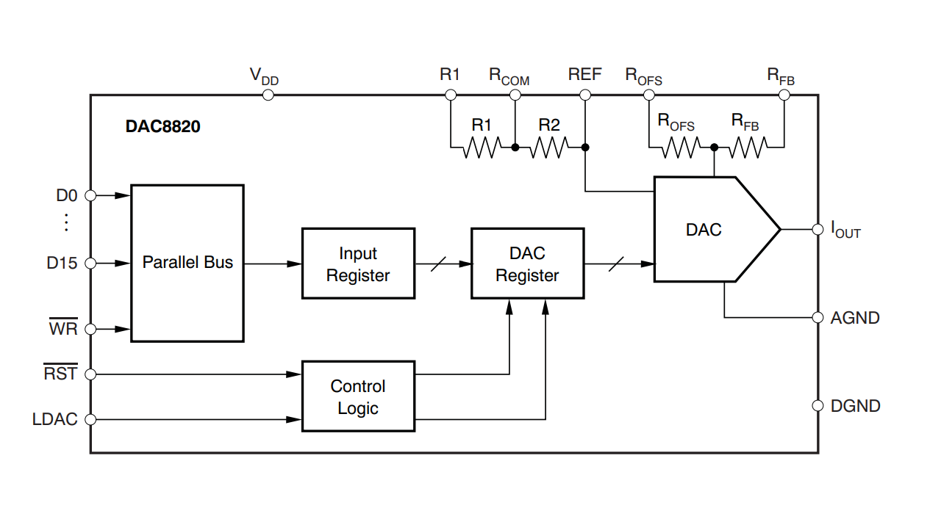
Digital to Analog Converter (DAC)
Convert digital data into an analog signal.
Using DAC8820.
Outputs current so a transimpedance amplifier is needed.
16-bit resolution for precise waves.

Slide 9
Execution and Validation Plan
Currently: subsystem general outlines, tentative selected parts, IDEs, studios, etc., beginning preliminary designs
 | October 2 | October 9 | October 16 | October 23 | October 30
Android App | All Button Functionality | 1 Working Function with Display Output & Preset Input | Implement Other Functions, Test User Input Functions | Implement Freehand Mode with Custom User Waveforms | Bluetooth Connection & Import/Export of CSV Files
Microcontroller | Part Delivered and Soldered | Successful Bluetooth Connection and Data Import | Program Clock Rate | Successful Data Export | Test connection, import, & export capabilities
FPGA | 50% board completion | 100% board completion | Order Board | Work on Verilog | final presentation
DAC | Schematic design with desired components | DAC and output circuitry for single channel generator | Update to incorporate dual channel function | PCB prep and design | Test final PCB for proper function

Slide 10
Questions?

